Slide 1
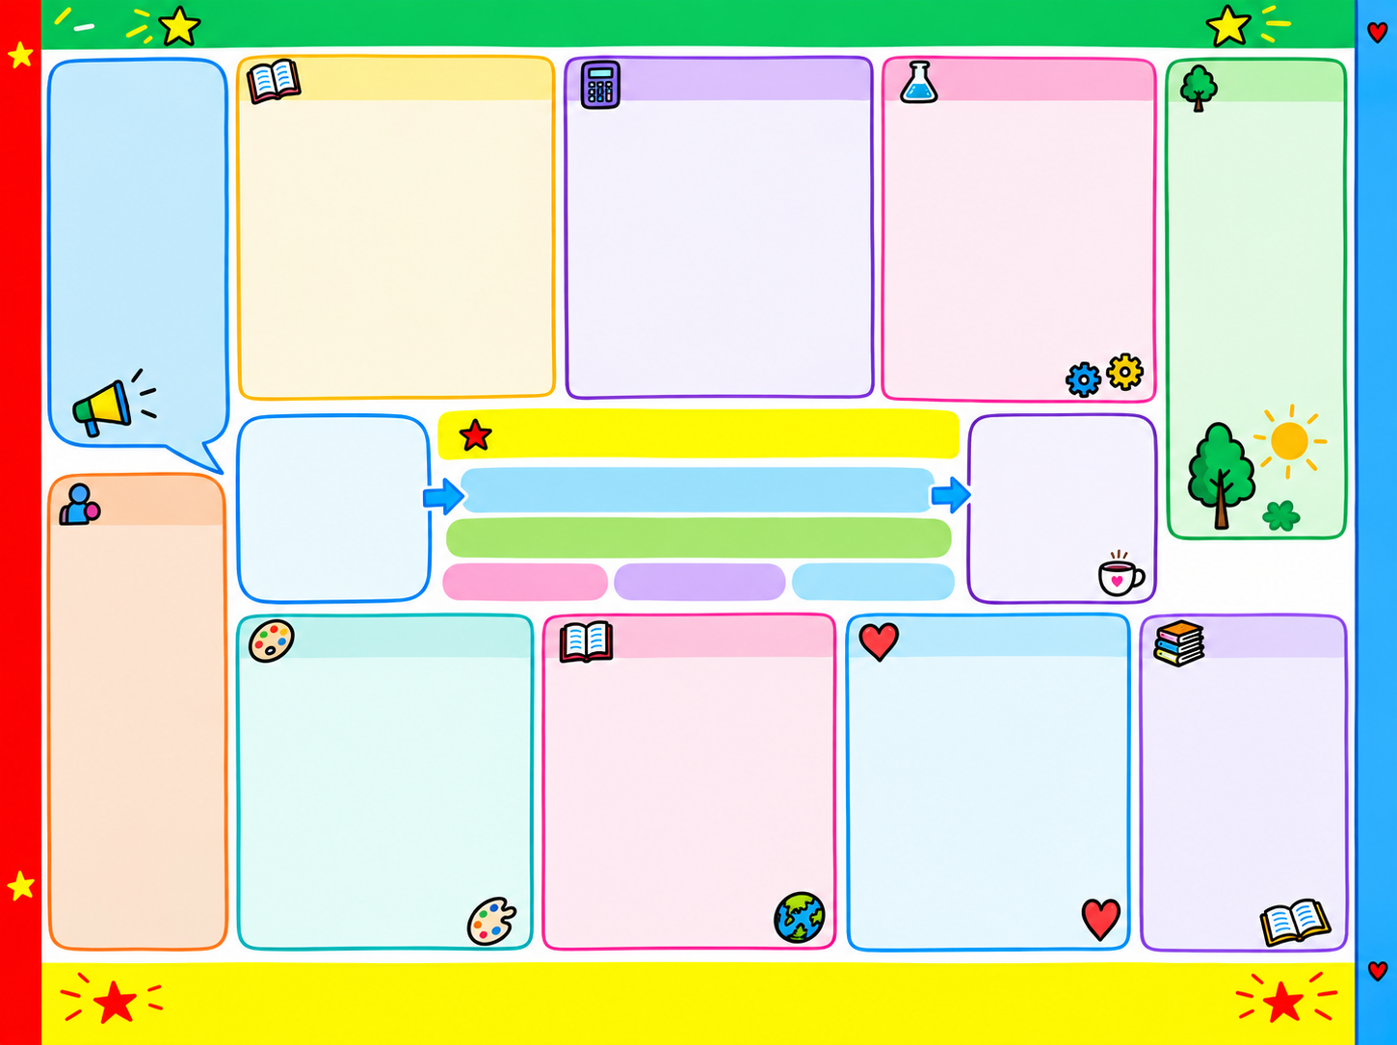
Dinasyddion moesegol, gwybodus sy’n barod i fod yn ddinasyddion Cymru a’r byd.
Science and Technology:
Sort and group information using ICT or charts to record simple results.
Describe what has been found and offer simple explanations when raising a question, exploring, experimenting and conducting a fair test.
Experiment with sound, light and shadows.
Learn how to use and log in to HWB.
Use the J2E application for a purpose. Use various apps on a daily basis.
Learner Voice
Who helps us at school?
Who helps us in the house?
What is the work of superheroes?
Learn new songs and move to music.
Read stories and play outside.
Languages and Communication:
Promote spoken language using the style of Pie Corbett to learn storytelling e.g. the little red riding hood.
Promote written language when creating a persuasive poster and writing a simple portrait.
Learn language patterns using the ‘Dewch i Gloncian' scheme on a daily basis.
Develop reading, writing and spelling skills while carrying out 'Tric a Chlic' activities.
Hold a discussion about our new theme and create mind maps.
Learn a new language/vocabulary by singing themed songs.
Create simple poetry using the onomatopoeia style about fireworks.
Listen and discuss pieces of poetry.
Mathematics and Numeracy:
Develop numeracy skills on the classroom floor and in the outer area.
Develop an understanding of the value of coins in role-playing situations.
Practice using and understanding the value of coins, when paying for items.
Understand and deconstruct non-standard units when measuring length, height and distance.
Use their knowledge of days of the week, months of the year and seasoning daily on the classroom floor.
Learning Outdoors:
Outer area.
Morriston Park
Forrest School
Christmas Concert
St David's Church Flower Festival.
Singing at the School's Mac Millan coffee afternoon.
Thanksgiving Service
Discuss the jobs of people who help us in the local community.
Year 1 Theme – Save the Day
Fabulous Finish
An afternoon of coffee and an informal concert to celebrate the creative work of the pupils.
Ddysgwyr uchelgeisiol, galluog y’n bared i ddysgu drwy gydol eu hoes.
Super Start
Playing a role in the ‘den' of the superheroes. Listen, watch and discuss her favourite characters.
Main Focus:
Languages and communication
Expressive arts
Visitors:
-The Vicar
-Coastguard
-Brynamman Cinema
-Visit to see the lifeboat and RNLI staff
-Mumbles Church
-Discuss who is helping you in our community.
Unigolion iach, hyderus sy’n barod i fyw bywyd llawn gwerthfawr fel aelodau gwerthfawr o gymdeithas.
Crosscurricular Skills
Numeracy
Literacy
Digital
Humanities:
Think of questions and ask questions about people who help us in the community.
Learn about people who help us and find out more about these superheroes by asking simple questions. How to get emergency memo help.
Religion, Values and Ethics
Learn about Christianity festivals e.g. Thanksgiving, Advent and Christmas.
Listen to the special stories out of the Bible.
Explore traits -What makes a good friend?
Learn about what makes places special to you? Why is it special?
Where is a special place for Christians in Morriston?
Visit to the Chapel/Church.
Health and Wellbeing
Follow the Jigsaw programme - ‘Me and my world' / 'Celebrating differences'
Celebrating the Rights of September, October, November and December
Understand the meaning of the Four Purposes and how to use them in our daily life.
Celebrating anti-bullying week.
Identify acceptable behaviour and give reasons for the choice. Create a class charter and understand the importance of striving to follow rules.
Participate in physical and fitness sessions.
Bookcase:
Story -Yr Hugain Fach Goch
Nurse-Ceri's Story
Miscellaneous Tric a chlic Books
Fireman Sam's Stories
Reading various comic strips
Poetry on the theme of Fireworks
Expressive Arts:
Sing a range of class/theme songs daily.
Learn the hymns of thanksgiving and Christmas carols.
Create sounds using percussion instruments.
Reflect on their own music and the music of superheroes.
Learn about the musical elements e.g. pitch and tempo.
Reflecting on Andy Warhol's pictures, reflecting on his style in creating his own portrait picture. Make choices when choosing materials and resources e.g. with paint and oil pastels.
Experimenting with digital art
Adopt a role in the superhero cave while role-playing.
Cyfranwyr mentrus, creadigol sy’n barod i chwarae rhan lawn yn eu bywyd a’u gwaith.

